Slide 1


Airline Safety Concerns & Covid-19 Impacts
DSC640 – Data Presentation & Visualization Sanjay Jaras

Slide 2
Overview
Due to Covid-19 & travel restrictions, the airline industry is going through tough times.
Due to recent unfortunate airline crashes, the media has been promoting statistics stating air is no longer a safe way to travel.
The news and media outlets have been bombarding the public with reports and figures about the trends of airline safety and that things are not looking good.
Air travel was previously thought as the safest way to travel, especially when compared to automobiles, is now being presented as one of the most dangerous to the public.
Based on data we tried to showcase the COVID-19 impacts & answer safety questions based on data available.

Slide 3
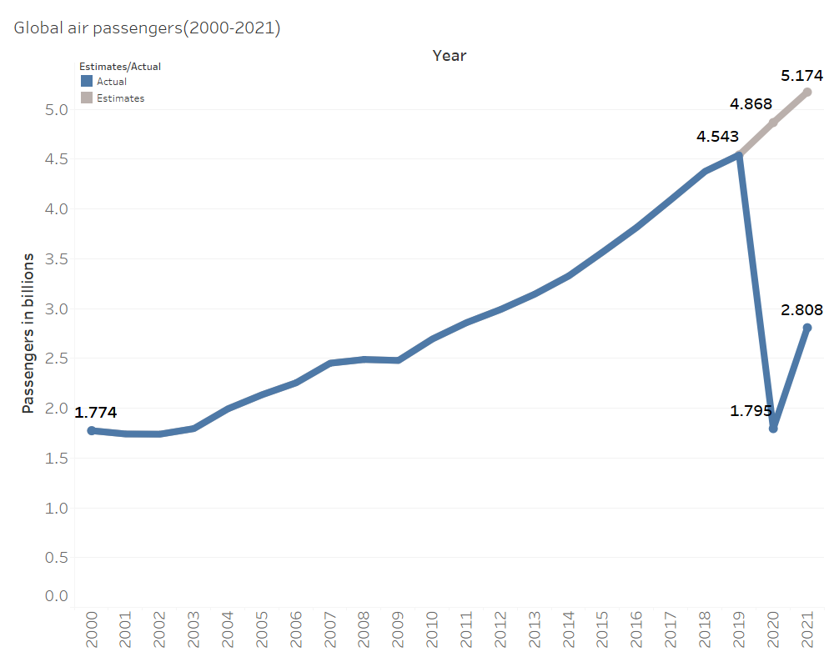
Covid-19 Impact – Low Passenger Volume
The number of air passengers increased consistently from the year 2000 through 2019 from 1.38 billion to 4.54. The number of air passengers traveled in the year 2020 is dropped to 1.79 billion in contrast to the 4.9 billion estimated
Source: Industry Statistics:

Slide 4
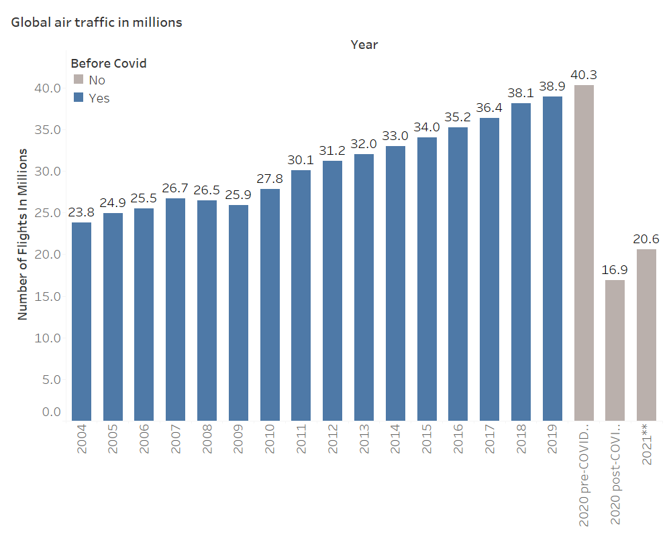
Covid-19 Impact – Low Flight Volume
Since the early 2000s, the number of flights increased from 23.8 to 38.9 million yearly by 2019. For the year 2020, roughly 40.3 million flights were scheduled however, only 16.9 million flights took off.
Source: Industry Statistics

Slide 5
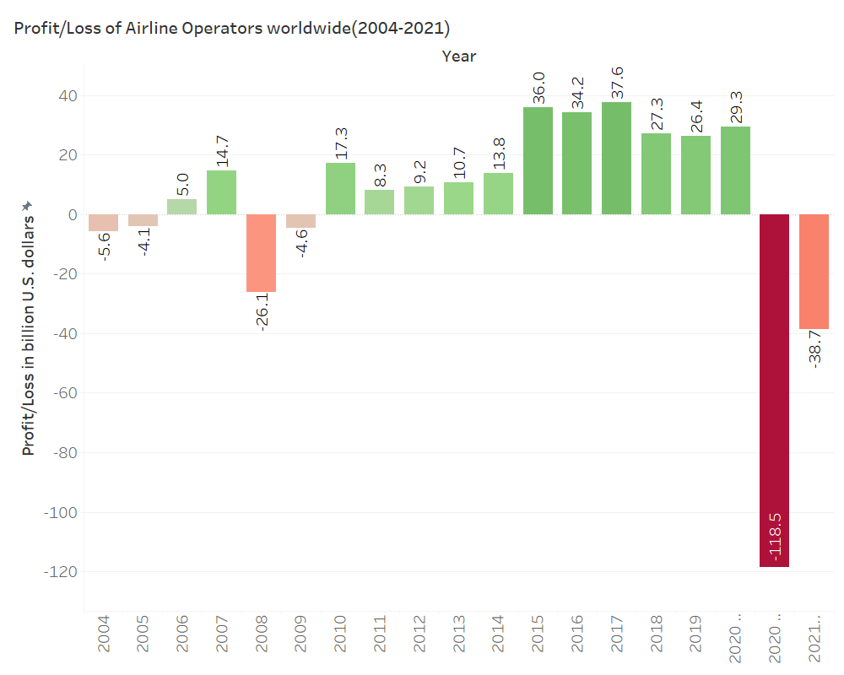
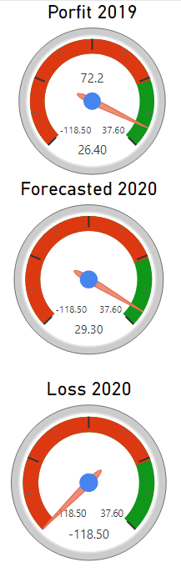
Covid-19 Impact – Heavy Loss in 2020
For the year 2020, the profit of $29 billion was forecasted however, due to covid-19, airline industry incurred a massive loss of $119 billion.
Source: Industry Statistics

Slide 6
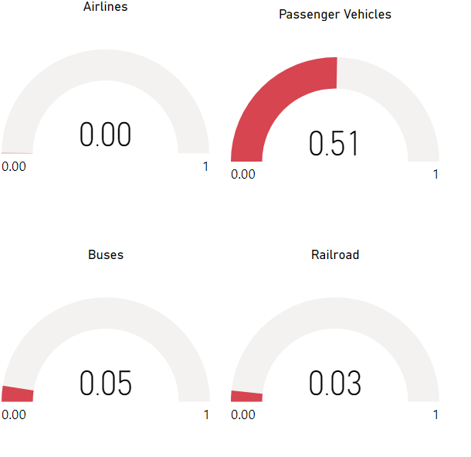




Safety Concern Answer – Safest Mode of Transport
Compared to other modes of transportation, the aviation industry has an average death rate of 0.003 per 100,000,000 passenger miles for the period 2007-2019.
Source: Industry Statistics

Slide 7
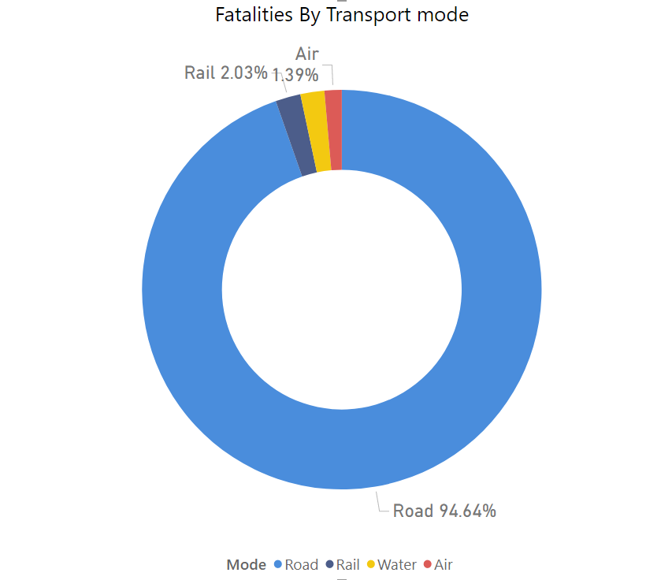
Safety Concern Answer – Less fatalities compared to other modes
From 2000 through 2019 airline industry contributed to 1.39% of fatalities as opposed to 94.6% by Road, 1.94% by water, and 2.03% by Railroad.
Source: Industry Statistics

Slide 8
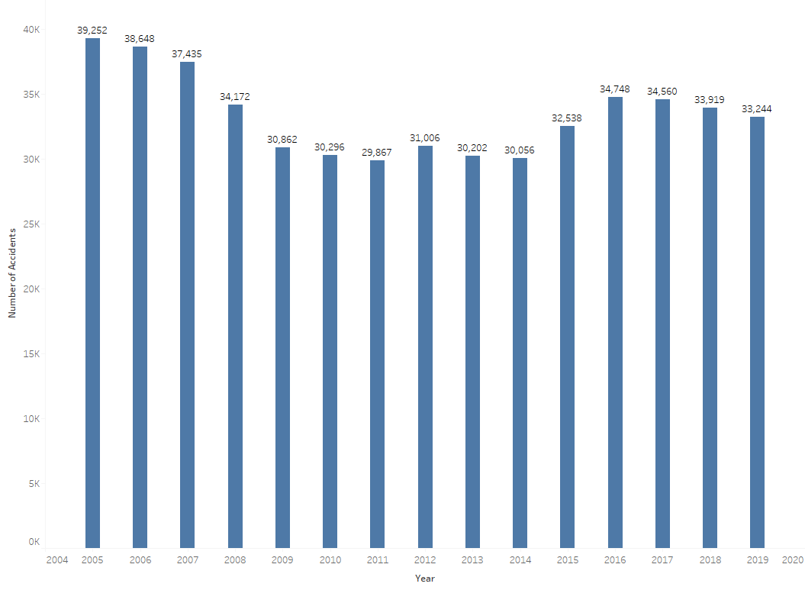
Fatal Road Accidents in U.S.(2005-2019)
On an average 33,387 fatal road accidents happened in U.S. in the period 2005-2019 per year.
While Air-travel has only 0.95 fatal accidents per year with U.S. operators.
Source: Airlines for America

Slide 9
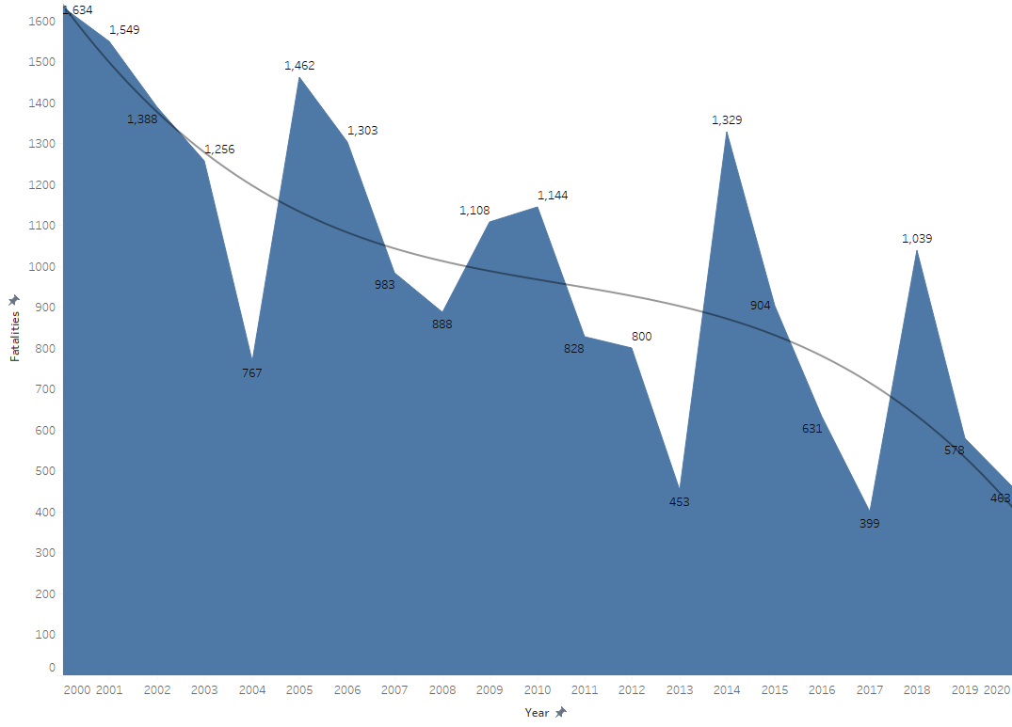
Safety Concern Answer – Fatalities Worldwide(2000-2020)
On average, 956 fatalities in airline accidents as compared to 33,000 average road accidents in the United States in the past 20 years. In past 20 year accident number came down by 35.3%.
Source: Bureau of Aircraft Accident Archives

Slide 10
Conclusion:
There is huge drop in passenger volume in year 2020.
Due to Covid-19 & travel restrictions, Global Airline industry saw huge $118 billion loss in year 2020.
As compared to other modes of transport, airline industry has lowest fatality rate.
The accident and fatality trend for aviation industry is showing downward trend.
Aviation industry is continuously working on improving safety.
Airline industry is going through tough times with heavy loss and safety concerns.
It needs our support and trust to come on track again.

Slide 11
Sources
Airline Safety: https://github.com/fivethirtyeight/data/tree/master/airline-safety
Aviation Safety: https://aviation-safety.net/database/
Bureau of Aircraft Accident Archives: https://www.baaa-acro.com/statistics/death-rate-per-year
Airline of America: https://www.airlines.org/dataset/safety-record-of-u-s-air-carriers/#
Industry Statistics: https://www.iata.org/en/iata-repository/publications/economic-reports/
National Highway Traffic Safety Administration Industry Statistics: https://cdan.dot.gov/
National Transportation Statistics - https://www.bts.gov/content/transportation-fatalities-mode
Industry Statistics: https://www.iata.org/en/iata repository/pressroom/fact-sheets/industrystatistic

Slide 12
Thank You !

